Slide 1
IBM Coursera Advanced Data Science Capstone
Kai Tan
Date: 01/02/2020

Slide 2
Dataset : House price prediction
Regression Problem
Kaggle - House Prices: Advanced Regression Techniques
Task: Predict House Prices

Slide 3
Use case
To assist house buyer and seller to predict house’s selling price.
Identify which house’s features has the most influence in price

Slide 4
Solution algorithm
Linear Regression
Using Gradient Boosting Regression
Random Forest Regression
Neural Network

Slide 5
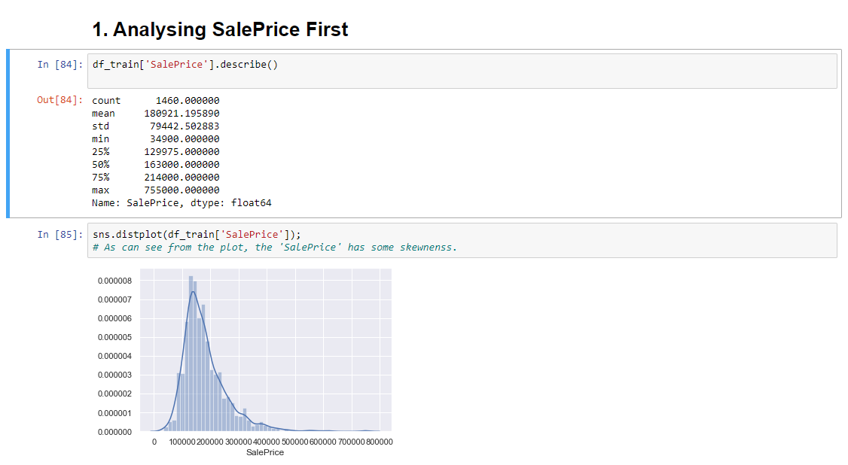
Analyzing Sale price

Slide 6
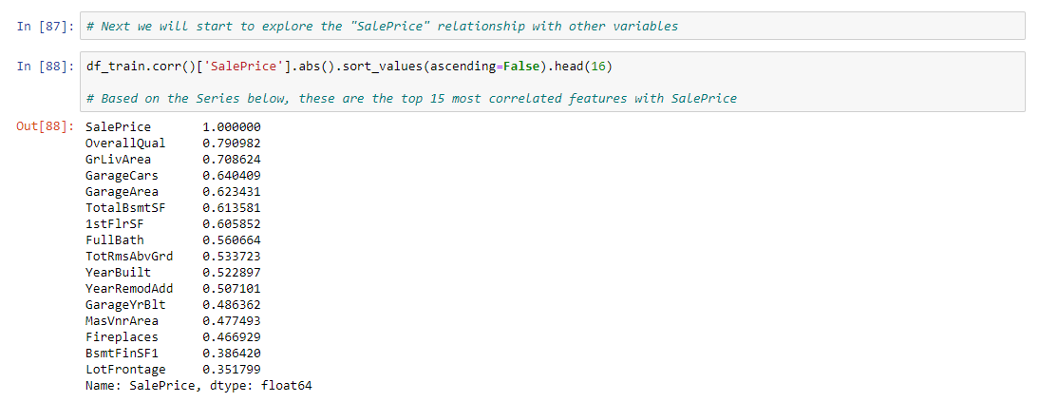

Slide 7
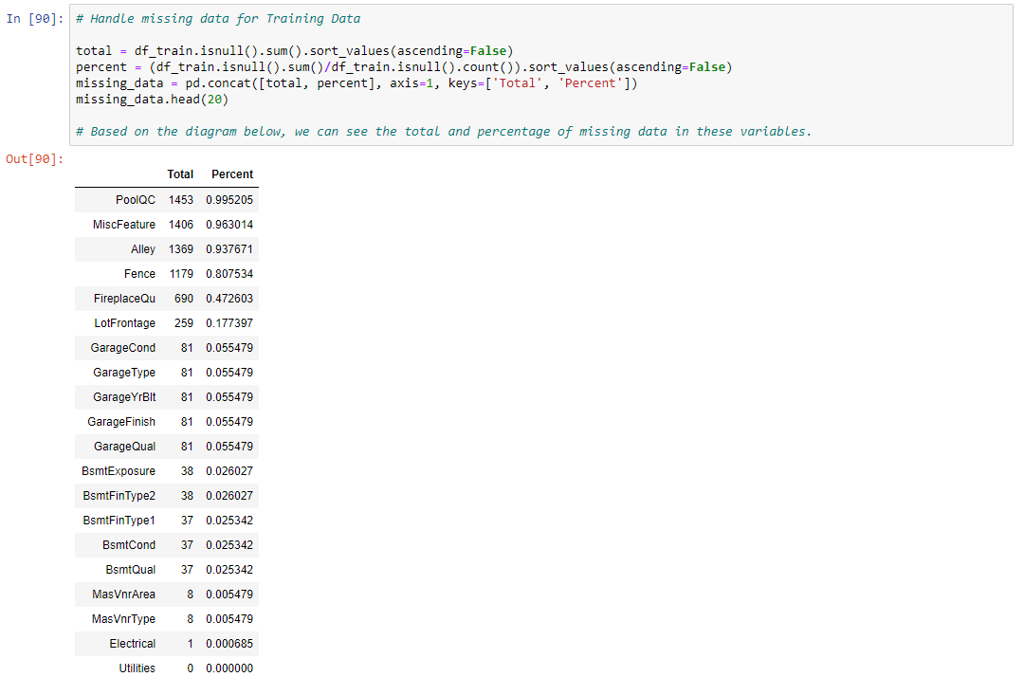
Handle Missing Data

Slide 8
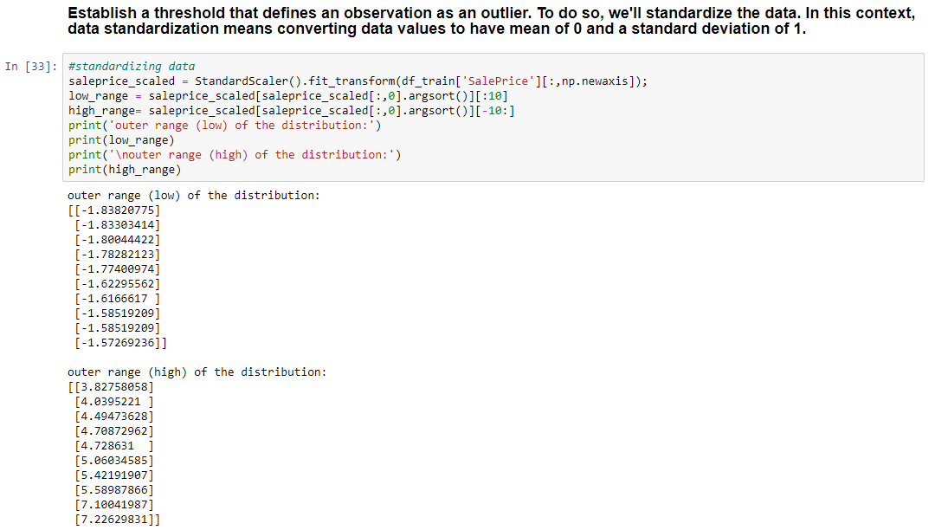
Handling outliers

Slide 9
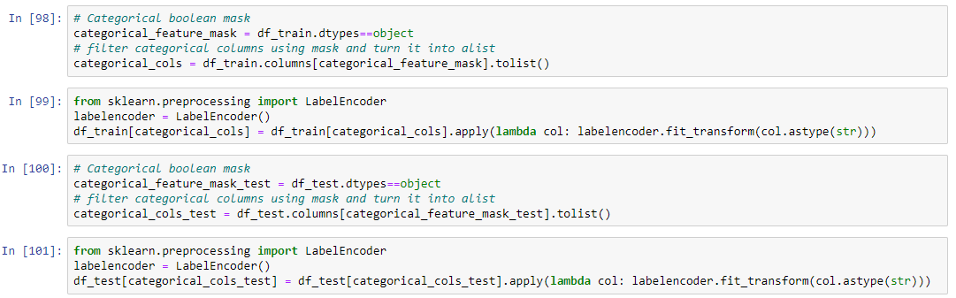
Convert categorical variable into Numeric

Slide 10
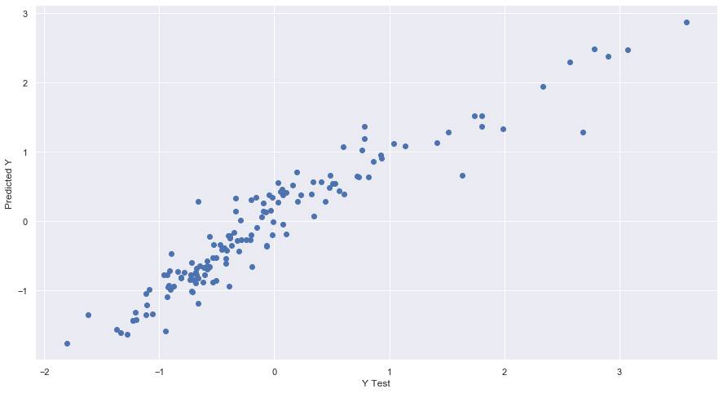
Linear Regression

Slide 11
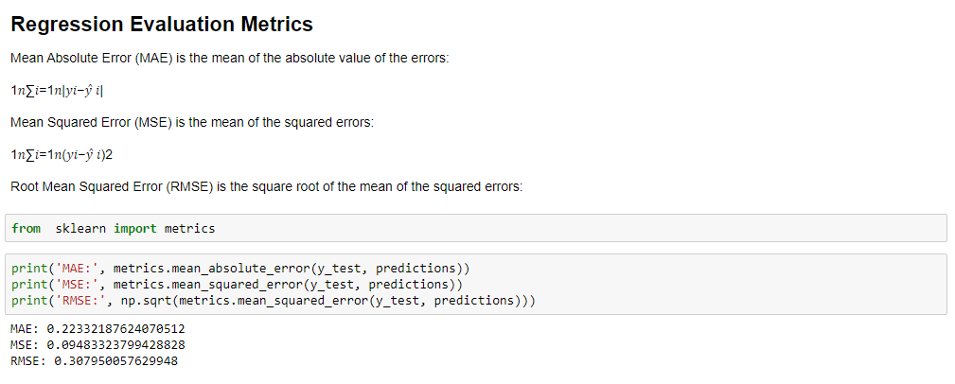

Slide 12
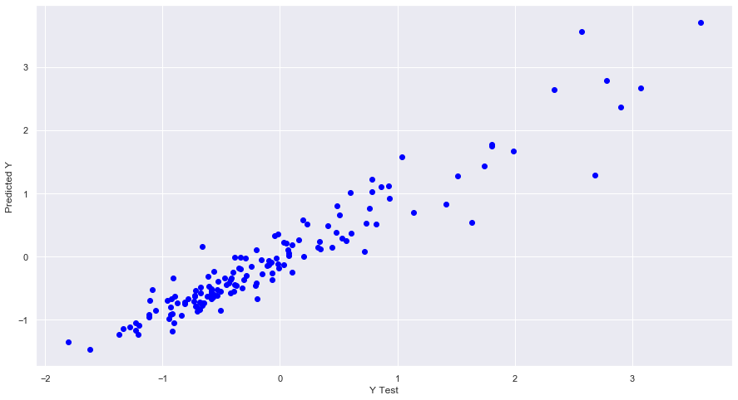
Gradient Boosting Regression

Slide 13
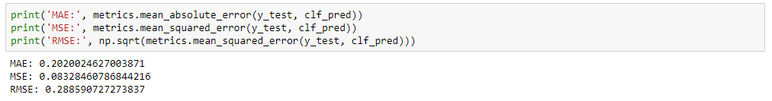

Slide 14
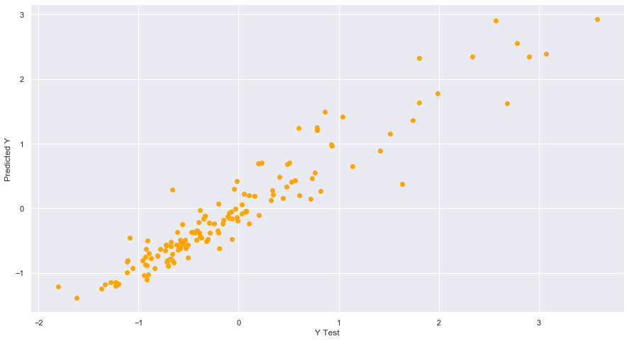
Random Forest Regression

Slide 15
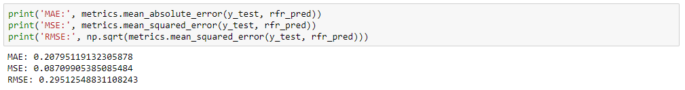

Slide 16
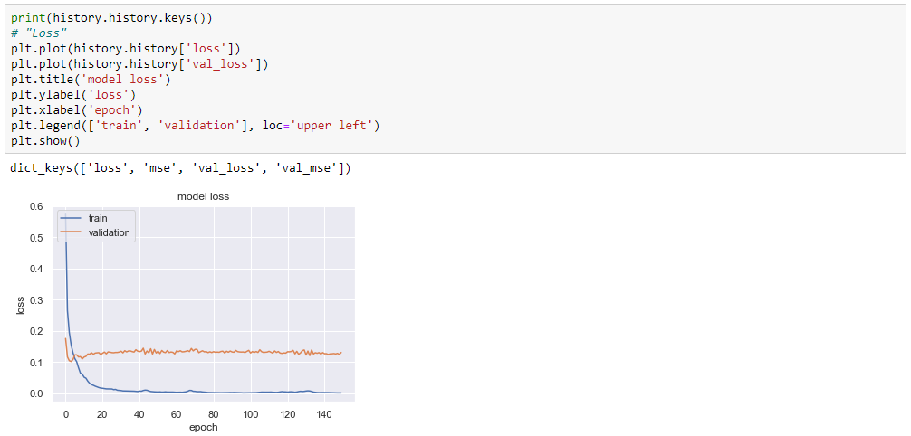
Neural Network

Slide 17
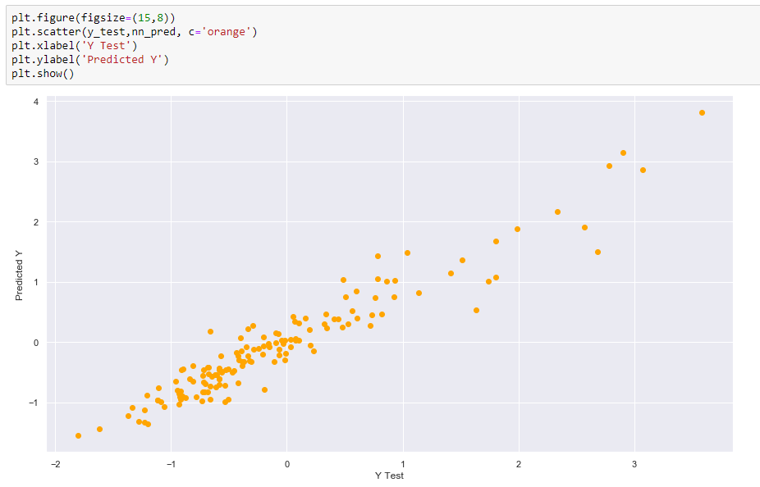

Slide 18
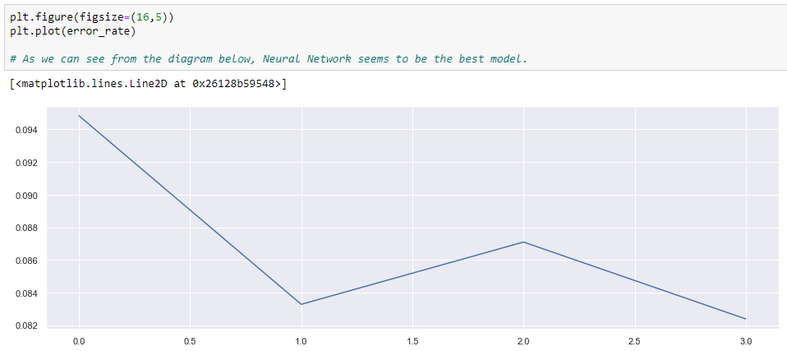
Comparing Error rate of different models
[On the x-axis]
0.0 = Linear Regression
1.0 = Gradient Boosting Regression
2.0 = Random Forest Regression
3.0 = Neural Network

Slide 19
THANK YOU!

